Slide 1
Data types
&
Bivariate Data
Year 10 2018

Slide 2
24
7
30
Date
Types of Data & Bivariate Data
EQ – What is bivariate data and how is it used?
What are the different types of data?
Data is classed into two groups either numerical or categorical
Data that goes into groups
Eg: what mode of transport did you take to school? (walk, ride, car)
What is categorical data?
Categorical
Nominal
(no implied order just names)
Ordinal
(the names of the categories suggest an order)
Favourite colour: blue, black, yellow
Fitness level : low, medium, high
5
Notes:
Lesson objective (EQ)

Slide 3
24
7
30
Date
Types of Data & Bivariate Data
EQ – What is bivariate data and how is it used?
What is numerical data?
Data that the answer has a numerical answer indicating size or amount
Eg: how many people live in your house?
Numerical
Think measuring!
Think counting!
Discrete
(specific integer values)
Continuous
(any value within a realistic range, limited by accuracy of measurement instrument)
How many people in your house?
How wide is the front of your house?
5
Notes:
Lesson objective (EQ)

Slide 4
24
7
30
Date
Types of Data & Bivariate Data
EQ – What is bivariate data and how is it used?
What is univariate data?
Univariate data is one piece of information about each thing
Bivariate data is two pieces of information which can show a relationship.
Eg: Weight and blood pressure, Time spent on homework and marks in a test
What is bivariate data?
This gives us two pieces of information we can express as an (x,y) coordinate. We are then able to plot and compare the values on a scatter plot.
What can we show with bivariate data?
5
Notes:
Lesson objective (EQ)

Slide 6

Interesting Fact!
The 1986 Space Shuttle Challenger disintegrated after the failure of an O-Ring seal.
It is claimed that improper analysis of the O-Ring temperature failure led to the disaster. Potentially proper analysis of the scatterplot and a line of best fit could have prevented the tragedy.

Slide 7
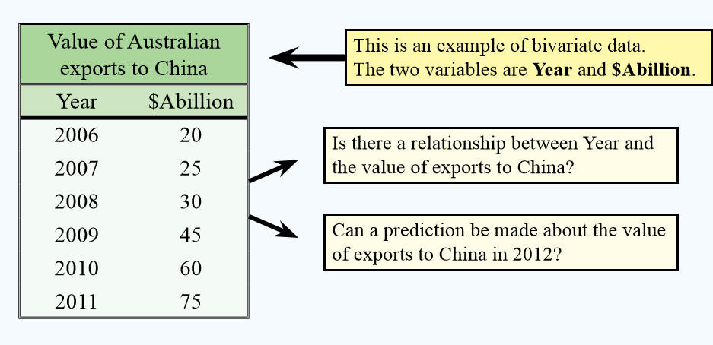
24
7
30
Date
Types of Data & Bivariate Data
EQ – What is bivariate data and how is it used?
With two variables and their relationship we can make predictions
How is bivariate data used?
Extrapolate means to use your model to find values beyond the x values you are given.
Interpolate means to use your model to find values within the x values you are given
5
Notes:
Lesson objective (EQ)

Slide 8
24
7
30
Date
Types of Data & Bivariate Data
EQ – What is bivariate data and how is it used?
If we suspect that there is a relationship between two variable, we can say that we think one is causing the other – their relationship could be CAUSAL.
Dependent variables rely on the change in the other variable. Should always be the y-axis.
Independent variables can change based on external factors. Should always be the x-axis
How can I determine dependent and independent variables

Slide 9
Add the following words to your glossary:
Extrapolate
Interpolate
Bivariate
Univariate
Categorical
Nominal
Ordinal
Numerical
Discrete
Continuous

